Slide 1
CS3081: “Artificial Intelligence”
Biological Intelligence, Machine Learning and Neural Networks
Prof Passent Elkafrawy
pelkafrawy@effatuniversity.edu.sa
CoE112, ext 7896

Slide 2
Outline
How do Humans do Intelligent Things?
What is Machine Learning? • What can Machine Learning do? • What is learning? • What types of Machine Learning exist
Evaluation (Issues) • Introduction to Neural Networks • ML in reality (pipeline) • AI, ML, and DL?
Some Current Artificial Neural Networks Applications
Limitations of Artificial Neural Network Systems
Resources
Inspired from:
Machine Learning 101, Tamer Elsayed
AI Modern approach, John A. Bullinaria

Slide 3
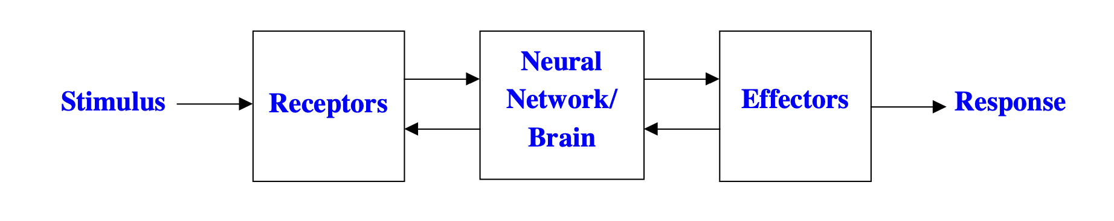
How do Humans do Intelligent Things?
Receptors collect information from the environment, and effectors generate interactions with the environment. The flow of information between them is represented by arrows
– both forward and backward
What we generally describe as “intelligence” is normally carried out in the central stage
– in the brain. The brain is known to consist of an interconnected network of neurons, and the study of neural networks is now a major sub-field of AI.

Slide 4
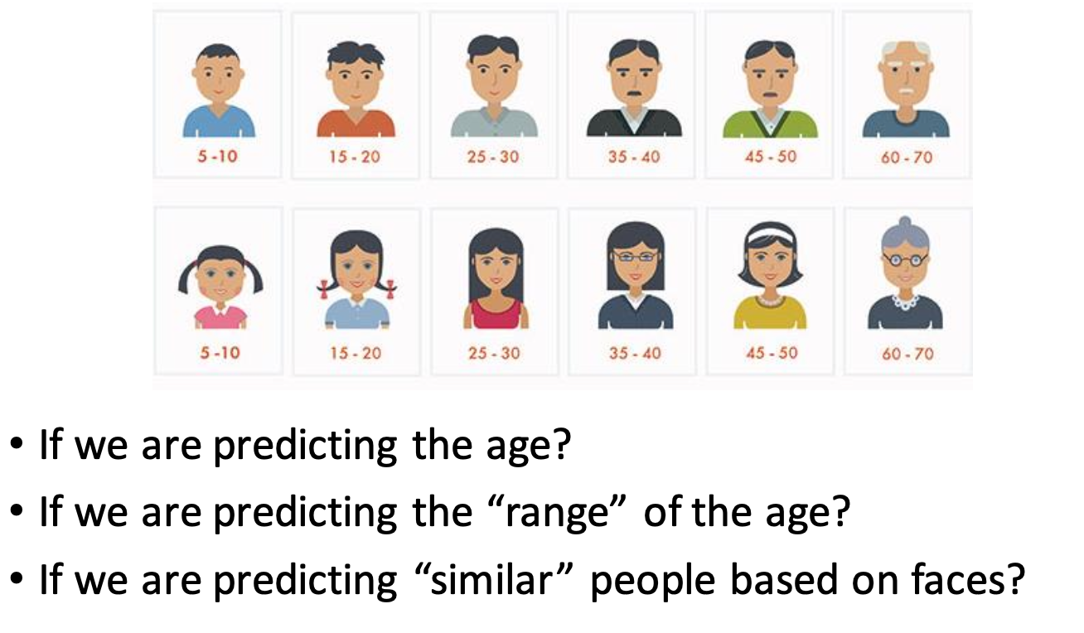
Type of machine learning problems

Slide 5
Why are Artificial Neural Networks worth studying?
They are extremely powerful computational devices (Turing equivalent, universal computers).
Massive parallelism makes them very efficient.
They can learn and generalize from training data – so there is no need for enormous feats of programming.
They are particularly fault tolerant – this is equivalent to the “graceful degradation” found in biological systems.
They are very noise tolerant – so they can cope with situations where normal symbolic systems would have difficulty.
In principle, they can do anything a symbolic/logic/rule based system can do, and more. (Though, in practice, getting them to do it can be rather difficult.)

Slide 6
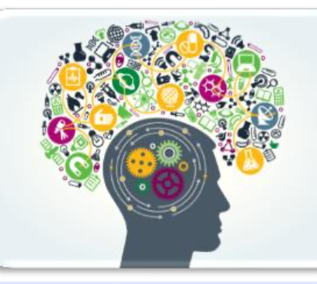
Artificial Neural Networks ?
As with the field of AI in general, there are two basic goals for neural network research:
Brain modelling : The scientific goal of building models of how real brains work. This can potentially help us understand the nature of human intelligence, formulate better teaching strategies, or better remedial actions for brain damaged patients.
Artificial System Building : The engineering goal of building efficient systems for real world applications. This may make machines more powerful, relieve humans of tedious tasks, and may even improve upon human performance.
Notes:
Turing believed that by the end of the 20th century it would be possible to program a digital computer toplaytheimitationgame. Althoughmodern computers still cannot pass the Turing test, it provides a basis for the verification and validation of knowledge-based systems.
I A program thought intelligent in some narrow area of expertise is evaluated by comparing its performance with the performance of a human expert.

Slide 7
Learning in ML-ANN
They are able to form appropriate mappings between input and output representations. One of the most important features of neural networks is their ability to learn and generalize from a set of training data. They adapt the strengths/weights of the connections between neurons so that each input produces the correct output.
There are three broad types of learning:
Supervised Learning (i.e. learning with a teacher),
Reinforcement learning (i.e. learning with limited feedback),
Unsupervised learning (i.e. learning with no help).

Slide 8
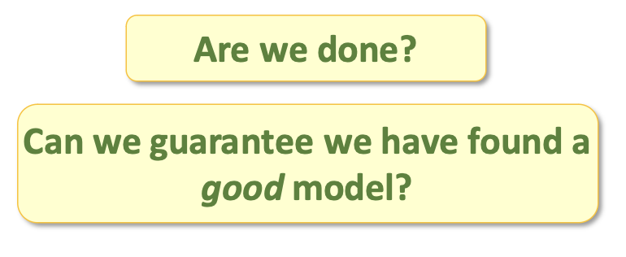
Evaluating the learning outcome
Assume we’ve learned a tree using the learning algorithm.
And it fits the training data perfectly.

Slide 9
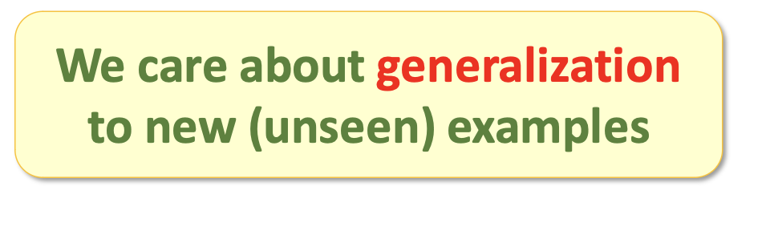
Training error is not sufficient!
Goal is NOT to build a model that gets 0% error on the training data.
this would be easy!
A tree can classify training data perfectly, yet classify new examples incorrectly.

Slide 10
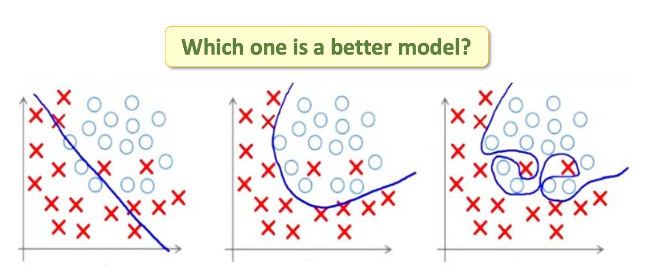
Overfitting / underfitting

Slide 11

Solution: evaluate test data
Set aside a test set − some examples that will be used for evaluation
training
testing
data

Slide 12
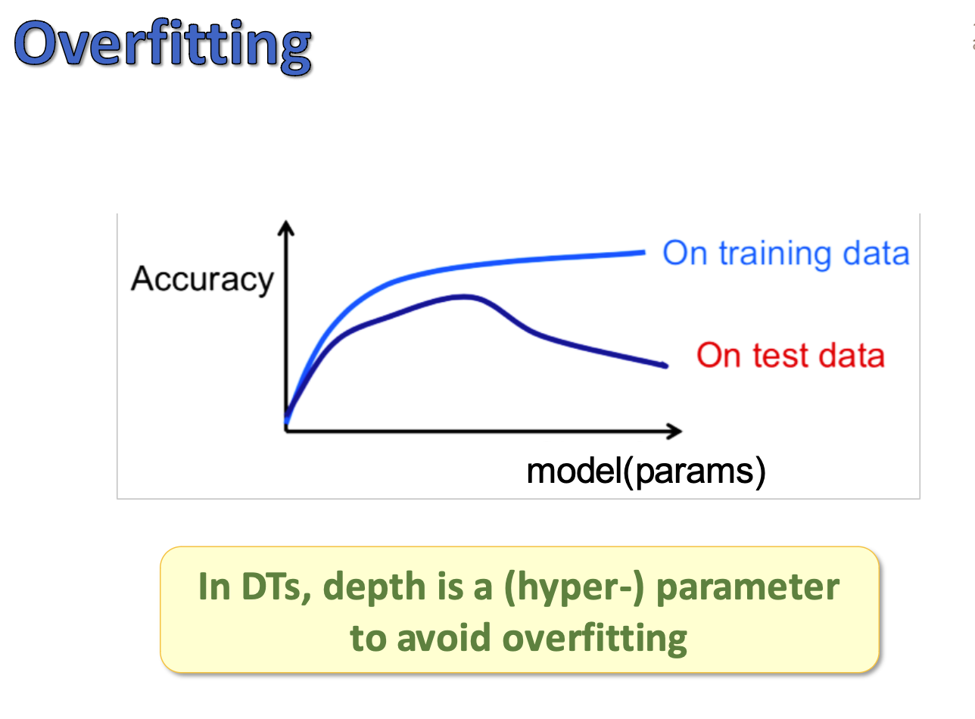
Overfitting

Slide 13
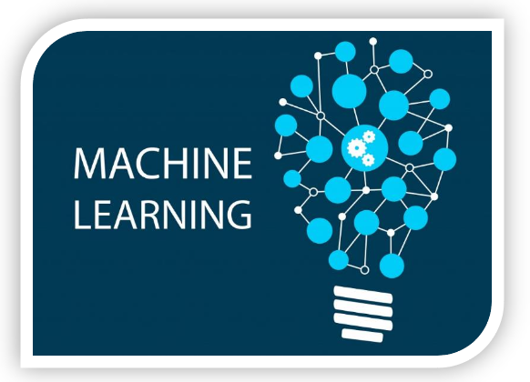
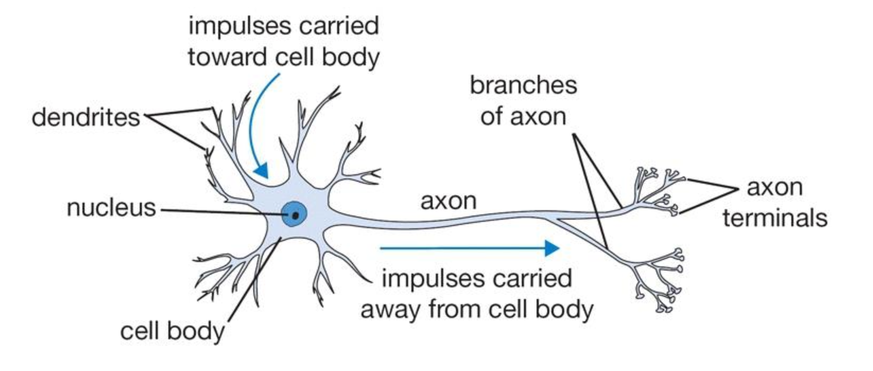
Biological inspiration

Slide 14
Basic Components of Biological Neurons
The majority of neurons encode their activations or outputs as a series of brief electrical pulses (i.e. spikes or action potentials).
The neuron’s cell body (soma) processes the incoming activations and converts them into output activations.
The neuron’s nucleus contains the genetic material in the form of DNA. This is the same as in most types of cells, not just neurons.
Dendrites are fibres which emanate from the cell body and provide the receptive zones that receive activation from other neurons.
Axons are fibres acting as transmission lines that send activation to other neurons.
The junctions that allow signal transmission between the axons and dendrites are called synapses. The process of transmission is by diffusion of chemicals called neurotransmitters across the synaptic cleft.

Slide 15
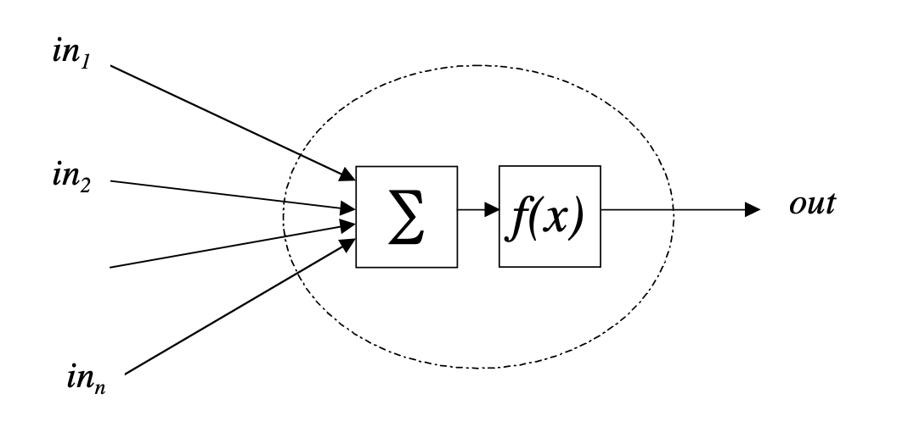
The Basic Artificial Neuron

Slide 16
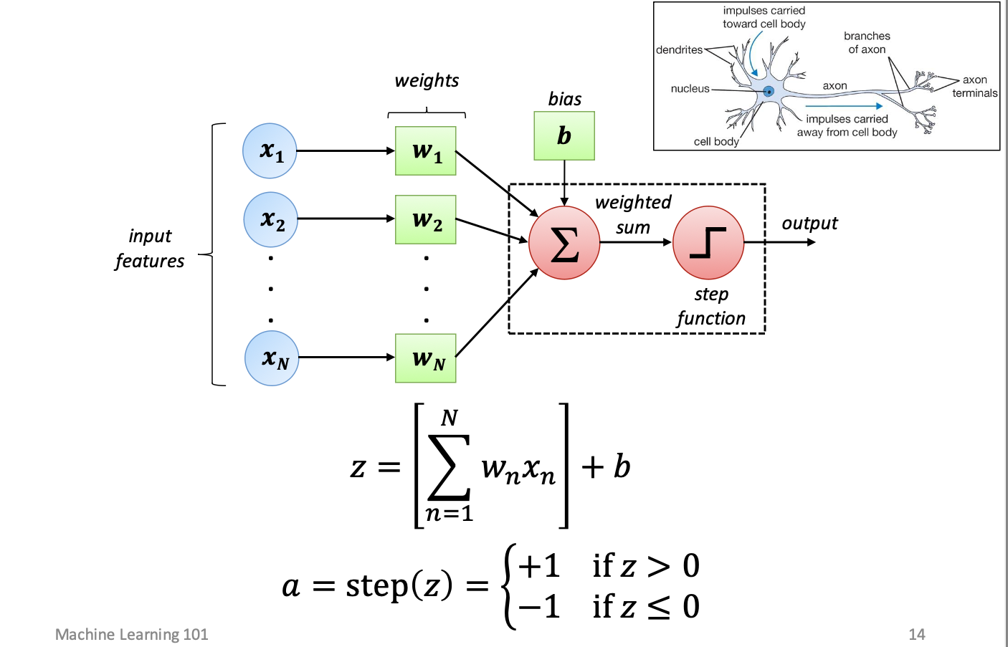
Perceptron: A Neuron..

Slide 17
Learning?
Model: The set of weights.
Training: Finding weights so that the “training” error is minimized.
Optimization problem

Slide 18
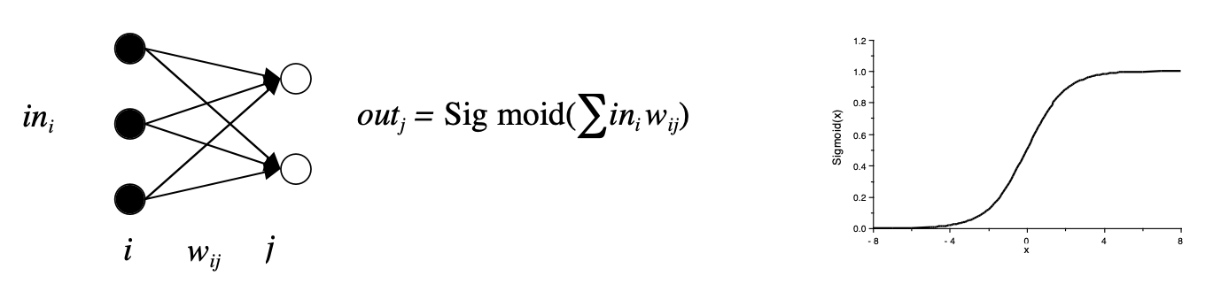
AAN
The inputs into each neuron j are the outputs of each connected neuron i multiplied by the corresponding connection strength/weight wij. Any pattern of connectivity is allowed, but one usually takes a simplified architecture (i.e. layout) for the network, e.g. two or three layers of neurons with full connectivity between layers and no connections within layers. The activations of the first layer are the network inputs.
We usually start the network with random initial connection weights wij and use a training algorithm to update them iteratively so that the correct outputs are produced for each input pattern in a set of training data. In this way the networks learn how to perform appropriately.

Slide 19
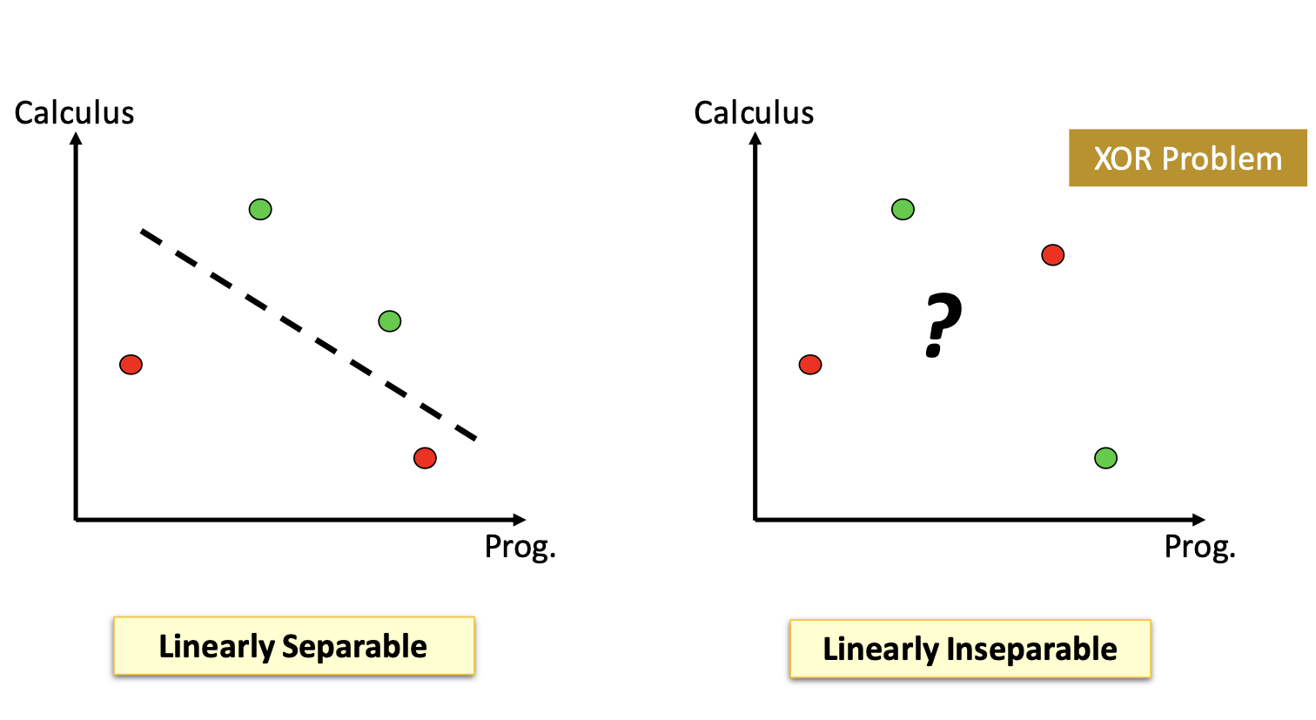
Perceptron is a linear model

Slide 22
Neural Networks
Combination of multiple perceptrons − Multilayer Perceptron (MLP)
Outputs of some neurons become inputs to other neurons.
Often organized into distinct layers of neurons.

Slide 28
Deep learning NN
if two-layer networks are so great, why do we care about deeper networks?
There are functions that requires a huge number of hidden units with shallow network, but can be done in a small number of units if deep.

Slide 30
Deep learning NN
if deep is potentially so much better, why don’t we always use deep networks?
• Needs lots of training data (to avoid overfitting!) • You need to choose how many layers, and the width of all
those layers! • Sometimes millions of parameters!
• Finding good ways to train deep networks is an active research area!
• In practice: go deep but not very deep!

Slide 33
developing techniques to enable computers to mimic human behavior
Produce “intelligent software” to (for example): − Automate routine labor (e.g., robots in factories) − Understand speech or images − make diagnoses in medicine
− and many other applications
The true challenge to AI: solving tasks easy for people to perform BUT hard to describe formally, e.g., recognizing spoken words or faces in images.

Slide 34
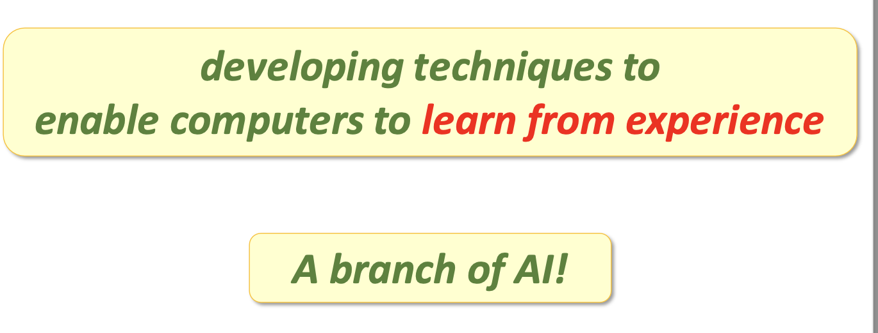
Machine Learning (ML)

Slide 35
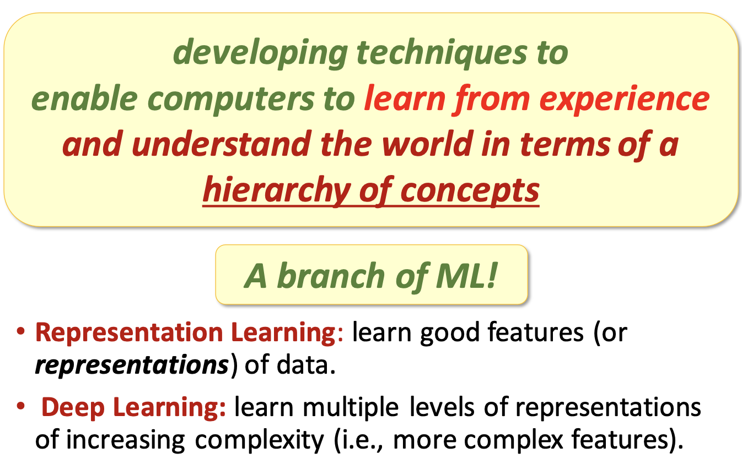
Deep Learning (DL)

Slide 37

Required background
Basic knowledge in: − Linear Algebra − Derivatives − Probability & Statistics
Online: Coursera Specialization!
Book: Mathematics for Machine Learning
Search for: “math4ml”

Slide 38
Languages − Python (recommended) −R
Tools/Libraries
− TensorFlow
− Keras − Scikit-learn
− PyTorch − Theano
(recommended) (recommended)
• Lots of tutorials online! • Book: Hands-On Machine Learning with Scikit-Learn and TensorFlow
Kaggle competitions/challenges
− www.kaggle.com

Slide 39
Reading
Nilsson: Chapter 3
Negnevitsky: Chapter 6
Callan: Chapter 15
Rich & Knight: Chapter 18
Russell & Norvig: Section 20.5

